Slide 1
12
The Central Nervous System: Part A

Slide 2
Central Nervous System (CNS)
CNS consists of brain and spinal cord
Cephalization
  Evolutionary development of rostral (anterior) portion of CNS
  Increased number of neurons in head
  Highest level reached in human brain

Slide 3
Embryonic Development
Brain and spinal cord begin as neural tube
3 primary vesicles form at anterior end
  Prosencephalon or forebrain
  Mesencephalon or midbrain
  Rhombencephalon or hindbrain
Posterior end becomes spinal cord

Slide 4
Embryonic Development
Primary vesicles → 5 secondary brain vesicles
  Forebrain → telencephalon and diencephalon
  Midbrain remains undivided
  Hindbrain → metencephalon and myelencephalon

Slide 5
Embryonic Development
Telencephalon → cerebral hemispheres
Diencephalon → epithalamus, thalamus, hypothalamus, and retina
Mesencephalon → midbrain
Metencephalon → pons and cerebellum
Myelencephalon → medulla oblongata
Central cavity of neural tube → ventricles

Slide 6
Embryonic Development
Brain grows faster than membranous skull
  Folds to occupy available space
  Forebrain moved toward brain stem (midbrain, pons, medulla oblongata)
  Cerebral hemispheres double back and envelop diencephalon and midbrain while creasing and folding to increase surface area

Slide 7
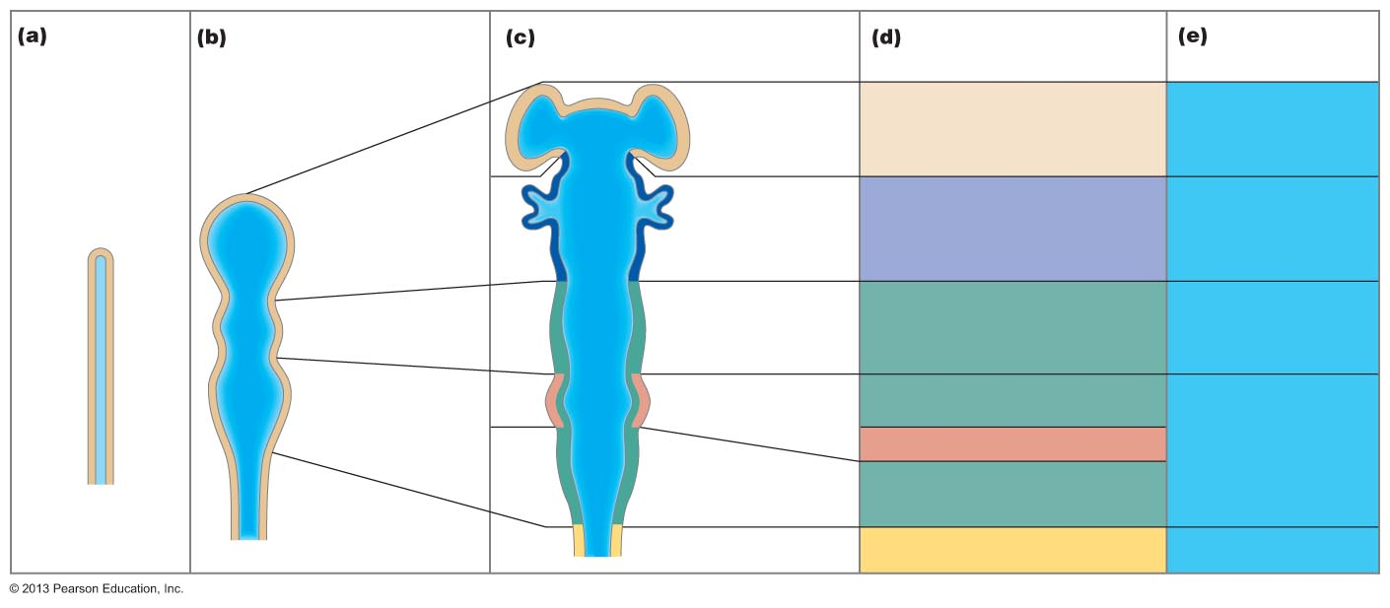
Figure 12.1 Embryonic development of the human brain.
Neural tube
(contains
neural
canal)
Primary brain vesicles
Secondary brain vesicles
Adult brain structures
Adult neural
canal regions
Telencephalon
Cerebrum: cerebral
hemispheres (cortex,
white matter, basal nuclei)
Lateral ventricles
Anterior
(rostral)
Prosencephalon
(forebrain)
Diencephalon
(thalamus, hypothalamus,
epithalamus), retina
Third ventricle
Diencephalon
Mesencephalon
(midbrain)
Mesencephalon
Brain stem: midbrain
Cerebral aqueduct
Rhombencephalon
(hindbrain)
Metencephalon
Brain stem: pons
Cerebellum
Fourth ventricle
Myelencephalon
Brain stem: medulla
oblongata
Posterior
(caudal)
Spinal cord
Central canal

Slide 8
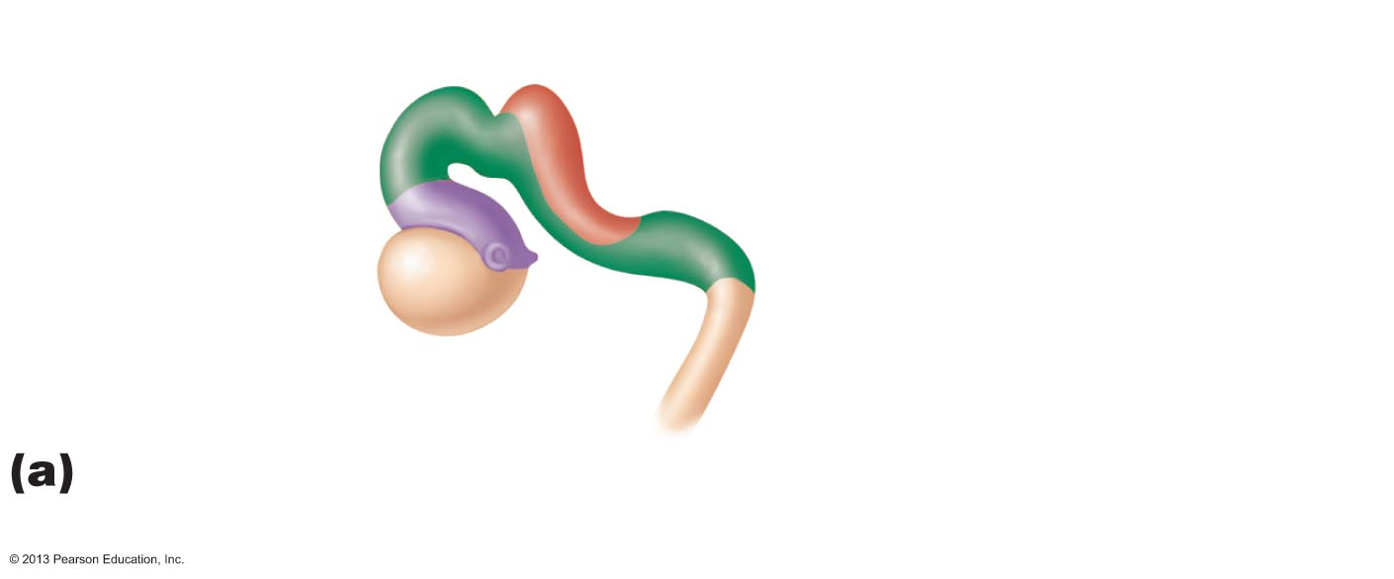
Figure 12.2a Brain development.
Anterior (rostral)
Posterior (caudal)
Metencephalon
Mesencephalon
Midbrain
Diencephalon
Flexures
Cervical
Telencephalon
Myelencephalon
Spinal cord
Week 5: Two major flexures form, causing the
telencephalon and diencephalon to angle toward the brain stem.

Slide 9
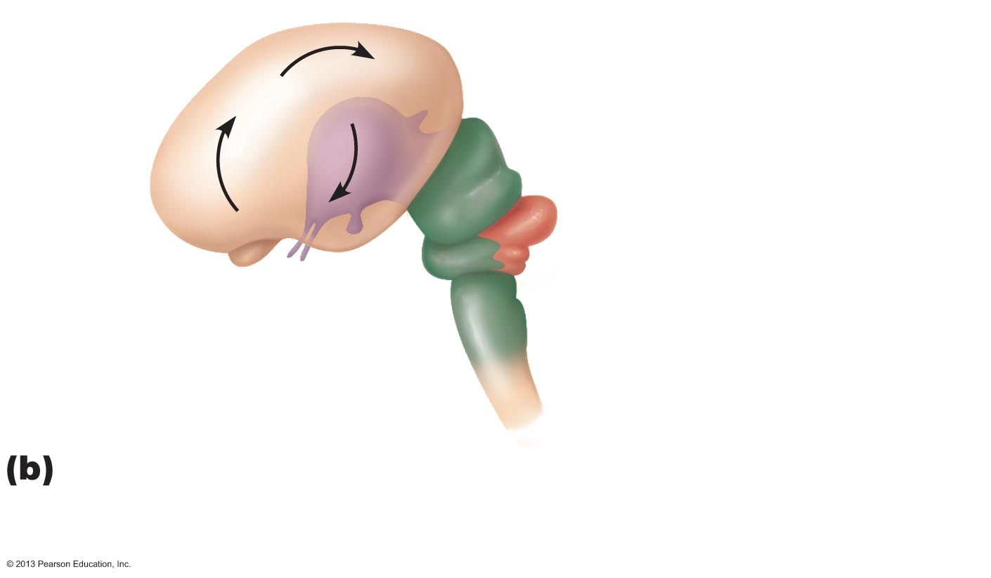
Figure 12.2b Brain development.
Cerebral hemisphere
Outline of diencephalon
Midbrain
Cerebellum
Pons
Medulla oblongata
Spinal cord
Week 13: Cerebral hemispheres develop and grow
posterolaterally to enclose the diencephalon and the
rostral brain stem.

Slide 10
Regions and Organization
Adult brain regions
  Cerebral hemispheres
  Diencephalon
  Brain stem (midbrain, pons, and medulla)
  Cerebellum

Slide 11
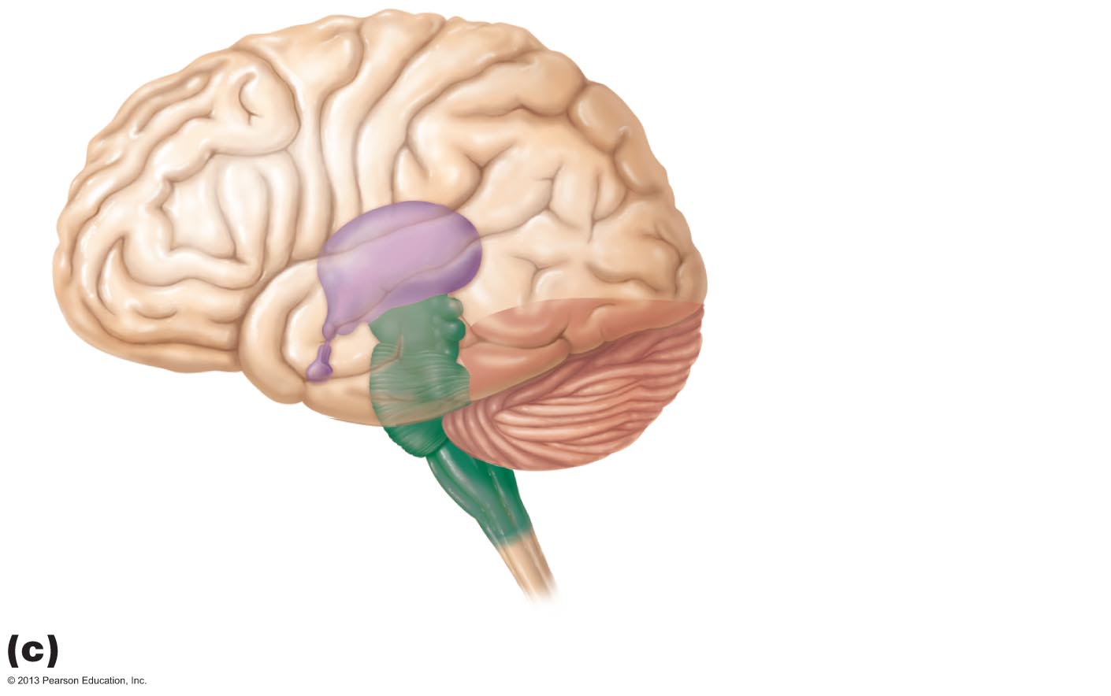
Figure 12.2c Brain development.
Cerebral
hemisphere
Diencephalon
Cerebellum
Brain stem
Midbrain
Pons
Medulla oblongata
Birth: Shows adult pattern of structures and convolutions.

Slide 12
Regions and Organization of the CNS
Spinal cord
  Central cavity surrounded by gray matter
  External white matter composed of myelinated fiber tracts

Slide 13
Regions and Organization of the CNS
Brain
  Similar pattern
  Additional areas of gray matter in brain
  Cerebral hemispheres and cerebellum
    Outer gray matter called cortex
  Cortex disappears in brain stem
    Scattered gray matter nuclei amid white matter

Slide 14
Ventricles of the Brain
Filled with cerebrospinal fluid (CSF)
Lined by ependymal cells
Connected to one another and to central canal of spinal cord
  Lateral ventricles → third ventricle via interventricular foramen
  Third ventricle → fourth ventricle via cerebral aqueduct

Slide 15
Ventricles of the Brain
Paired, C-shaped lateral ventricles in cerebral hemispheres
  Separated anteriorly by septum pellucidum
Third ventricle in diencephalon
Fourth ventricle in hindbrain
  Three openings: paired lateral apertures in side walls; median aperture in roof
    Connect ventricles to subarachnoid space

Slide 16
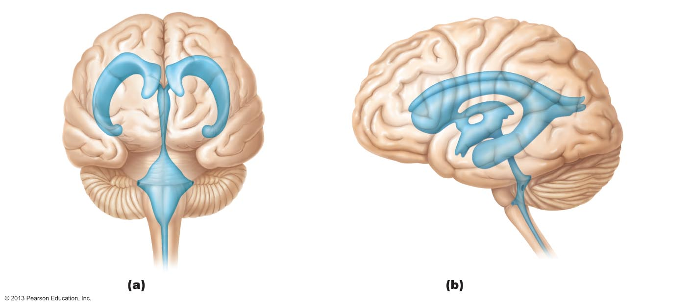
Figure 12.3 Ventricles of the brain.
Lateral
ventricle
Anterior
horn
Posterior
horn
Septum
pellucidum
Interventricular
foramen
Inferior
horn
Third
ventricle
Inferior
horn
Lateral
aperture
Cerebral aqueduct
Median
aperture
Fourth ventricle
Lateral
aperture
Central canal
Anterior view
Left lateral view

Slide 17
Cerebral Hemispheres
Surface markings
  Ridges (gyri), shallow grooves (sulci), and deep grooves (fissures)
  Longitudinal fissure
    Separates two hemispheres
  Transverse cerebral fissure
    Separates cerebrum and cerebellum

Slide 18
Cerebral Hemispheres
Five lobes
  Frontal
  Parietal
  Temporal
  Occipital
  Insula
PLAY
Animation: Rotatable brain

Slide 19
Cerebral Hemispheres
Central sulcus
  Separates precentral gyrus of frontal lobe and postcentral gyrus of parietal lobe
Parieto-occipital sulcus
  Separates occipital and parietal lobes
Lateral sulcus outlines temporal lobes

Slide 20
Cerebral Hemispheres
Three basic regions
  Cerebral cortex of gray matter superficially
  White matter internally
  Basal nuclei deep within white matter

Slide 21
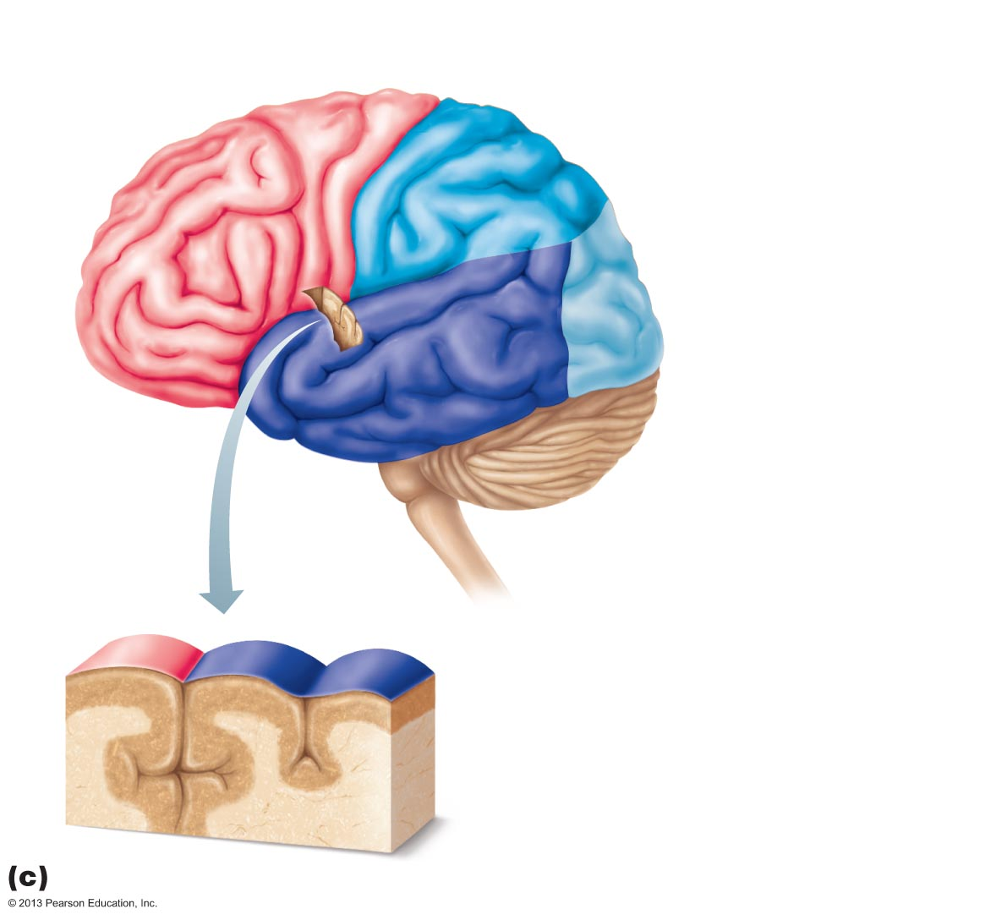
Figure 12.4c Lobes, sulci, and fissures of the cerebral hemispheres.
Precentral
gyrus
Central
sulcus
Postcentral
gyrus
Frontal lobe
Parietal lobe
Parieto-occipital sulcus
(on medial surface
of hemisphere)
Lateral sulcus
Occipital lobe
Temporal lobe
Transverse
cerebral fissure
Cerebellum
Pons
Medulla oblongata
Fissure
(a deep
sulcus)
Spinal cord
Gyrus
Cortex (gray matter)
Sulcus
White matter
Lobes and sulci of the cerebrum

Slide 22
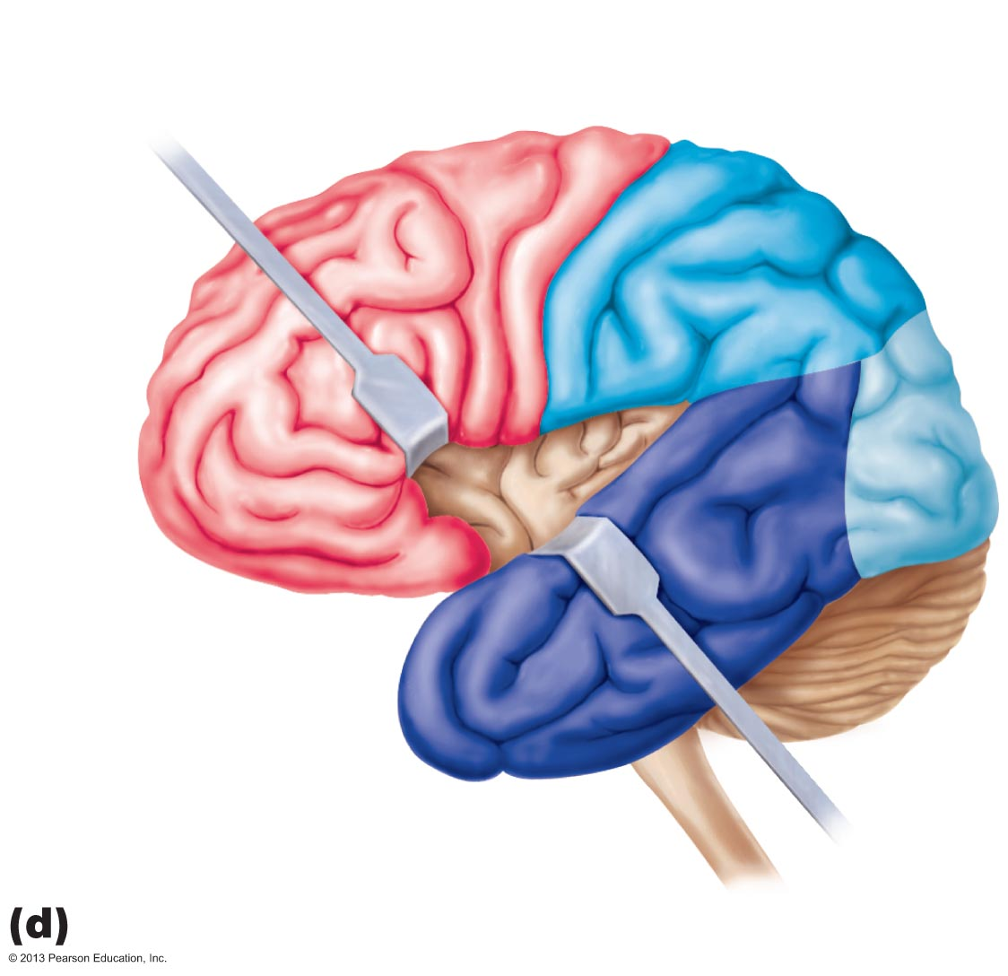
Figure 12.4d Lobes, sulci, and fissures of the cerebral hemispheres.
Central
sulcus
Frontal lobe
Gyri of insula
Temporal lobe
(pulled down)
Location of the insula lobe

Slide 23
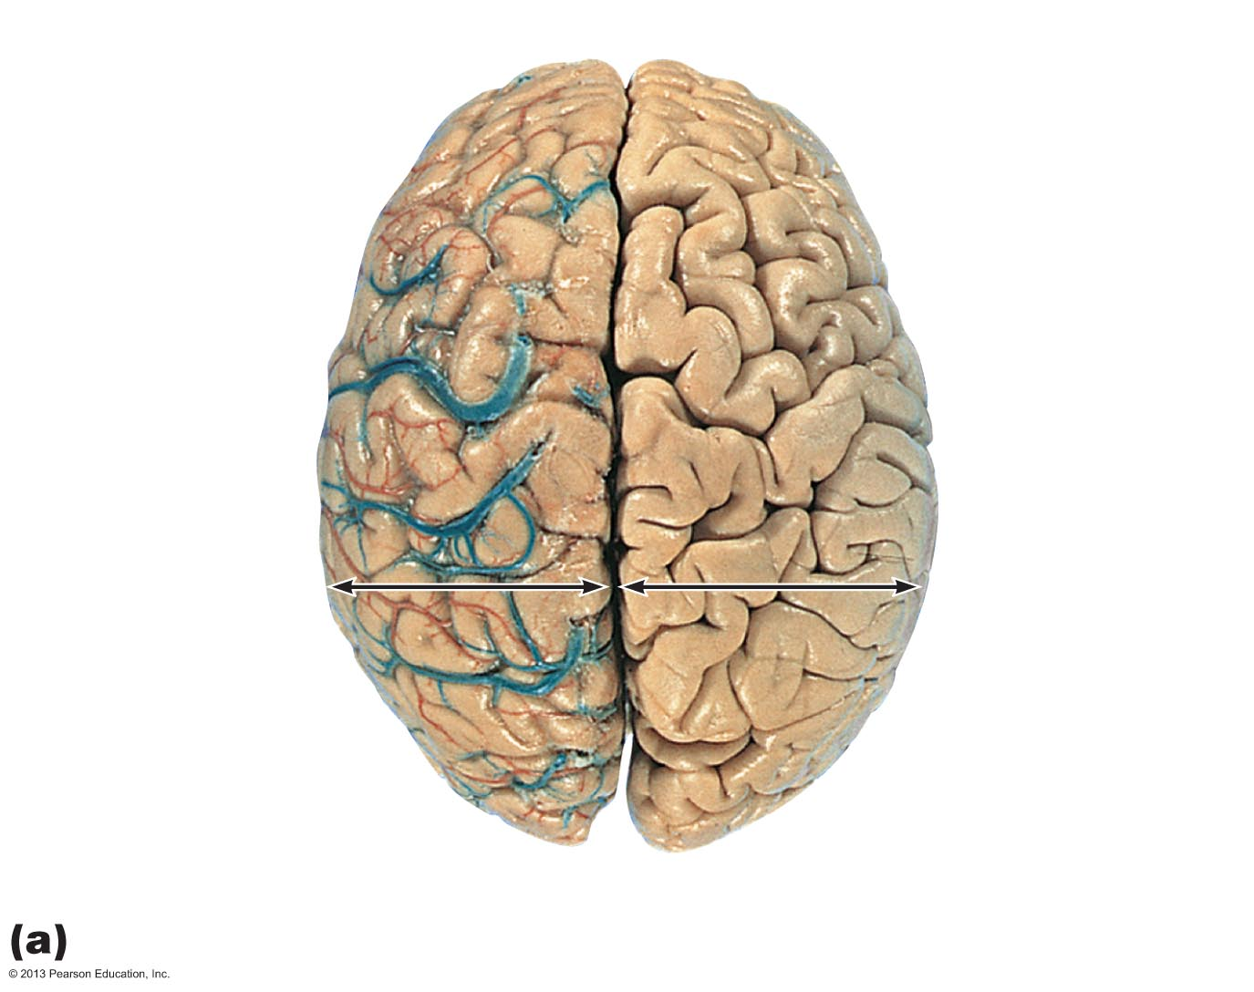
Figure 12.4a Lobes, sulci, and fissures of the cerebral hemispheres.
Anterior
Longitudinal
fissure
Frontal lobe
Cerebral veins
and arteries
covered by
arachnoid
mater
Parietal lobe
Left cerebral
hemisphere
Right cerebral
hemisphere
Occipital
lobe
Posterior
Superior view

Slide 24
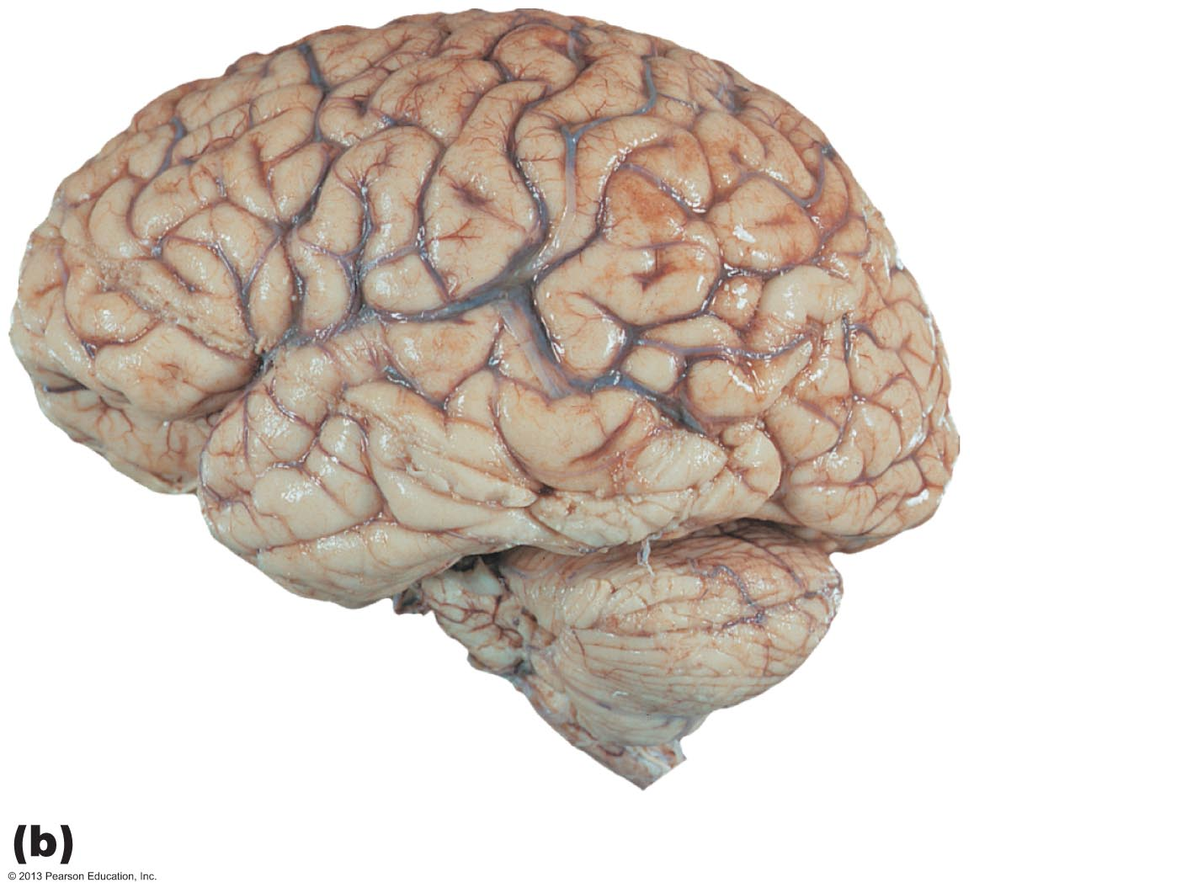
Figure 12.4b Lobes, sulci, and fissures of the cerebral hemispheres.
Left cerebral
hemisphere
Transverse
cerebral
fissure
Brain stem
Cerebellum
Left lateral view

Slide 25
Cerebral Cortex
Thin (2–4 mm) superficial layer of gray matter
40% mass of brain
Site of conscious mind: awareness, sensory perception, voluntary motor initiation, communication, memory storage, understanding

Slide 26
4 General Considerations of Cerebral Cortex
Three types of functional areas
  Motor areas—control voluntary movement
  Sensory areas—conscious awareness of sensation
  Association areas—integrate diverse information
Each hemisphere concerned with contralateral side of body

Slide 27
4 General Considerations of Cerebral Cortex
Lateralization of cortical function in hemispheres
Conscious behavior involves entire cortex in some way

Slide 28
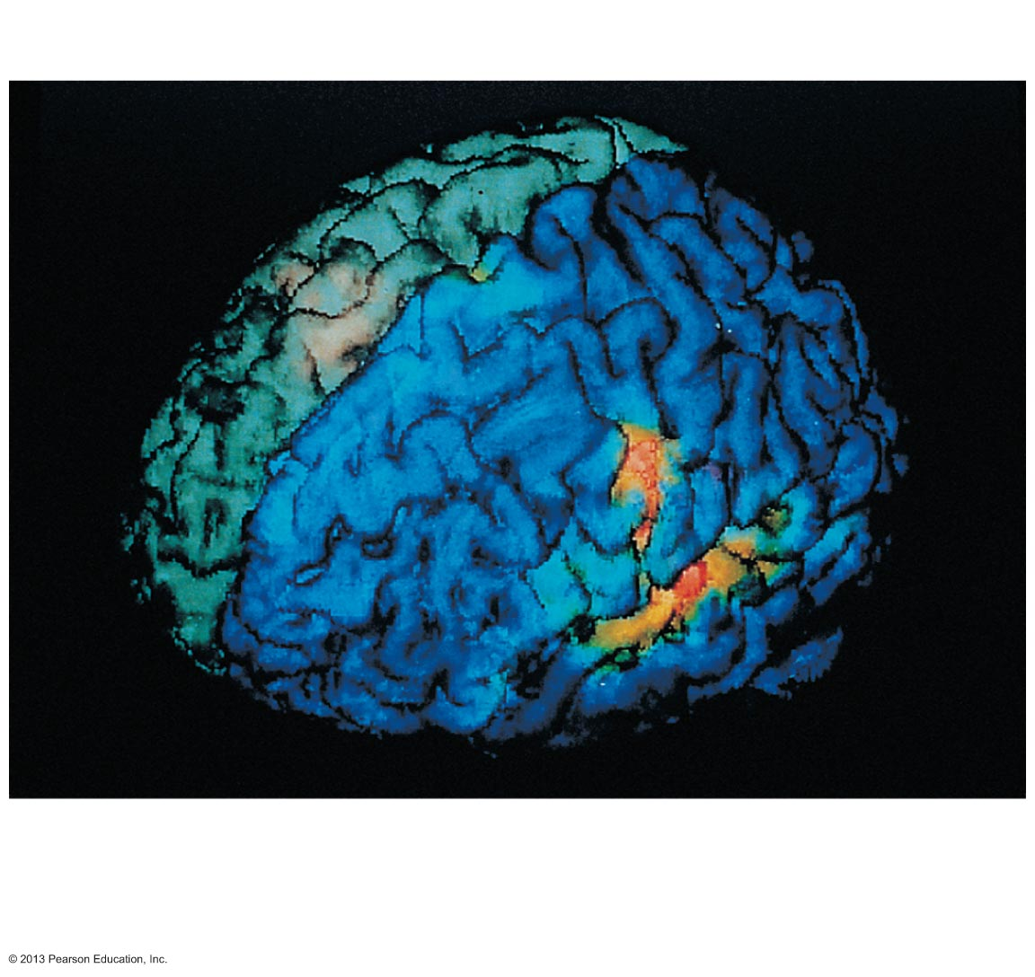
Figure 12.5 Functional neuroimaging (fMRI) of the cerebral cortex.
Central sulcus
Longitudinal
fissure
Left frontal
lobe
Left temporal
lobe
Areas active
in speech and
hearing (fMRI)

Slide 29
Motor Areas of Cerebral Cortex
In frontal lobe; control voluntary movement
Primary (somatic) motor cortex in precentral gyrus
Premotor cortex anterior to precentral gyrus
Broca's area anterior to inferior premotor area
Frontal eye field within and anterior to premotor cortex; superior to Broca's area

Slide 30
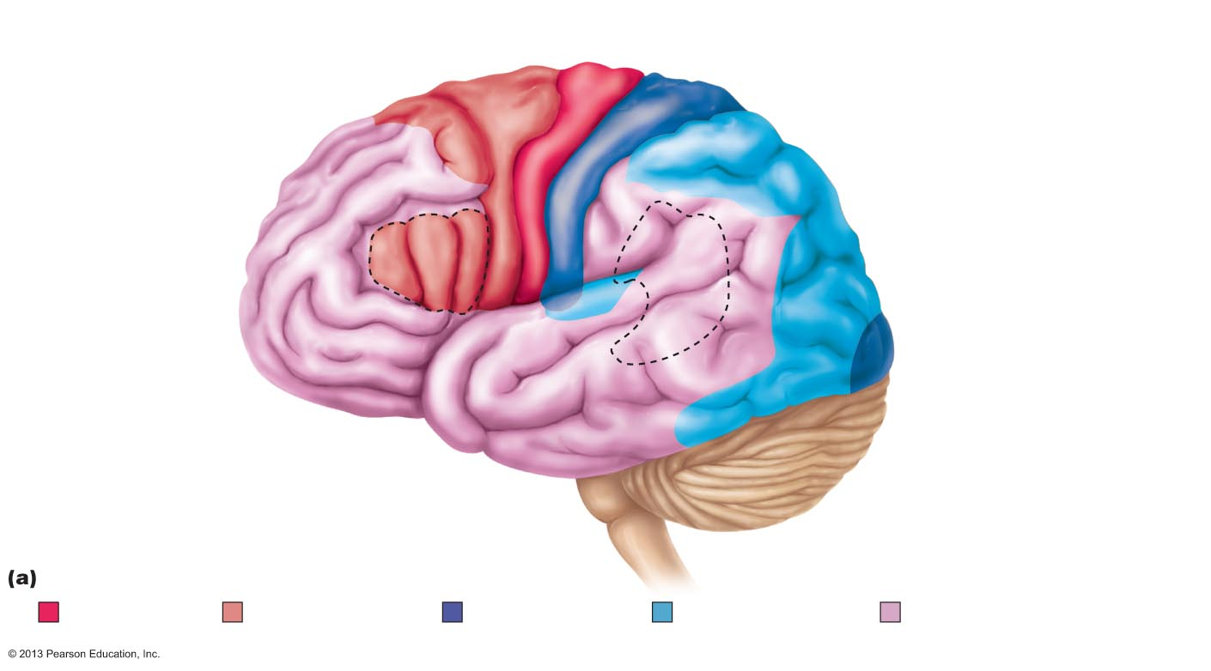
Figure 12.6a Functional and structural areas of the cerebral cortex.
Motor areas
Central sulcus
Sensory areas and related
association areas
Primary motor cortex
Primary somatosensory
cortex
Premotor cortex
Somatic
sensation
Frontal
eye field
Somatosensory
association cortex
Broca's area
(outlined by dashes)
Gustatory cortex
(in insula)
Taste
Prefrontal cortex
Working memory
for spatial tasks
Wernicke's area
(outlined by dashes)
Executive area for
task management
Working memory for
object-recall tasks
Primary visual
cortex
Solving complex,
multitask problems
Visual
association
area
Vision
Auditory
association area
Primary
auditory cortex
Hearing
Lateral view, left cerebral hemisphere
Primary motor
cortex
Motor association
cortex
Primary sensory
cortex
Sensory
association cortex
Multimodal association
cortex

Slide 31
Primary Motor Cortex
Large pyramidal cells of precentral gyri
Long axons → pyramidal (corticospinal) tracts of spinal cord
Allows conscious control of precise, skilled, skeletal muscle movements
Motor homunculi - upside-down caricatures represent contralateral motor innervation of body regions

Slide 32
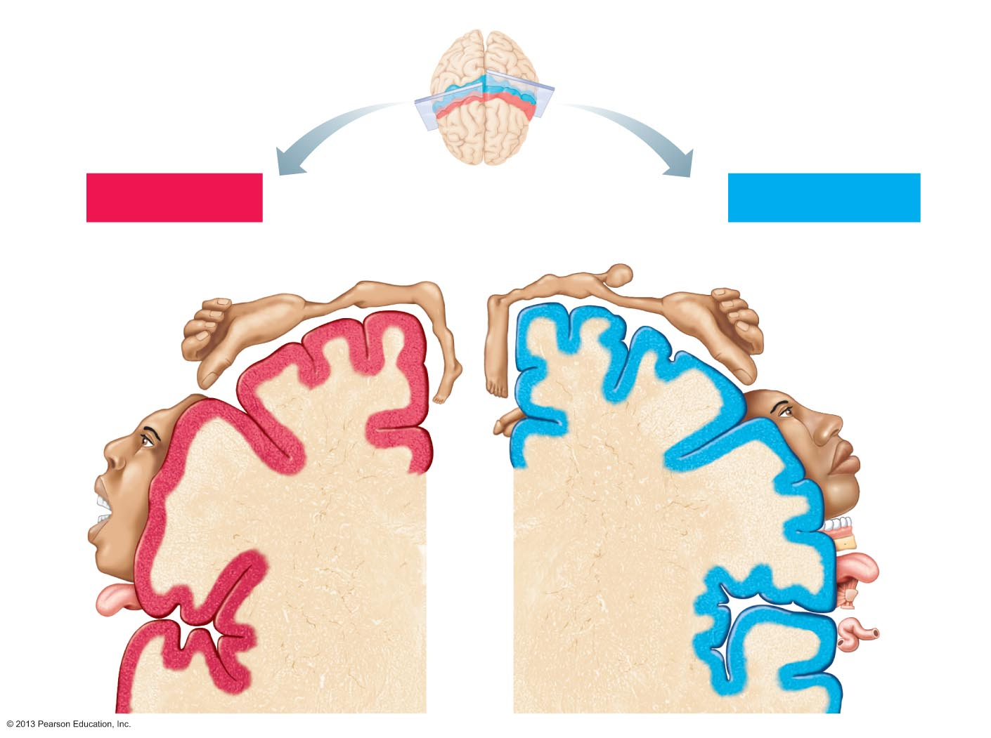
Figure 12.7 Body maps in the primary motor cortex and somatosensory cortex of the cerebrum.
Posterior
Motor
Sensory
Motor map in
precentral gyrus
Anterior
Sensory map in
postcentral gyrus
Shoulder
Trunk
Head
Neck
Forearm
Trunk
Hip
Arm
Leg
Arm
Hip
Knee
Elbow
Elbow
Hand
Wrist
Hand
Fingers
Fingers
Knee
Thumb
Foot
Thumb
Neck
Eye
Brow
Nose
Eye
Toes
Face
Face
Genitals
Lips
Lips
Teeth
Gums
Jaw
Jaw
Tongue
Tongue
Primary motor
cortex
(precentral gyrus)
Primary somato-
sensory cortex
(postcentral gyrus)
Pharynx
Swallowing
Intra-
abdominal

Slide 33
Premotor Cortex
Helps plan movements; staging area for skilled motor activities
Controls learned, repetitious, or patterned motor skills
Coordinates simultaneous or sequential actions
Controls voluntary actions that depend on sensory feedback

Slide 34
Broca's Area
Present in one hemisphere (usually the left)
Motor speech area that directs muscles of speech production
Active in planning speech and voluntary motor activities

Slide 35
Frontal Eye Field
Controls voluntary eye movements

Slide 36
Figure 12.6a Functional and structural areas of the cerebral cortex.
Motor areas
Central sulcus
Sensory areas and related
association areas
Primary motor cortex
Primary somatosensory
cortex
Premotor cortex
Somatic
sensation
Frontal
eye field
Somatosensory
association cortex
Broca's area
(outlined by dashes)
Gustatory cortex
(in insula)
Taste
Prefrontal cortex
Working memory
for spatial tasks
Wernicke's area
(outlined by dashes)
Executive area for
task management
Working memory for
object-recall tasks
Primary visual
cortex
Solving complex,
multitask problems
Visual
association
area
Vision
Auditory
association area
Primary
auditory cortex
Hearing
Lateral view, left cerebral hemisphere
Primary motor
cortex
Motor association
cortex
Primary sensory
cortex
Sensory
association cortex
Multimodal association
cortex

Slide 37
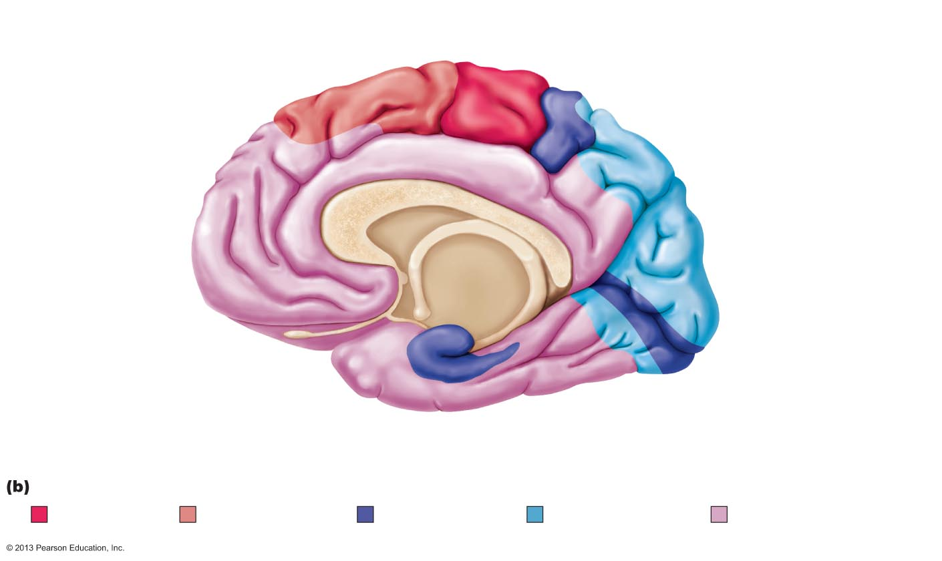
Figure 12.6b Functional and structural areas of the cerebral cortex.
Premotor
cortex
Cingulate
gyrus
Primary
motor cortex
Central sulcus
Corpus
callosum
Primary somatosensory
cortex
Frontal eye field
Parietal lobe
Prefrontal
cortex
Somatosensory
association cortex
Parieto-occipital
sulcus
Processes emotions
related to personal
and social interactions
Occipital
lobe
Orbitofrontal
cortex
Visual association
area
Olfactory bulb
Primary
visual cortex
Olfactory tract
Calcarine
sulcus
Fornix
Uncus
Parahippocampal
gyrus
Temporal
lobe
Primary
olfactory
cortex
Parasagittal view, right cerebral hemisphere
Primary motor
cortex
Motor association
cortex
Primary sensory
cortex
Sensory
association cortex
Multimodal association
cortex

Slide 38
Sensory Areas of Cerebral Cortex
Conscious awareness of sensation
Occur in parietal, insular, temporal, and occipital lobes
Primary somatosensory cortex
Somatosensory association cortex
Visual areas
Auditory areas
Vestibular cortex
Olfactory cortex
Gustatory cortex
Visceral sensory area

Slide 39
Primary Somatosensory Cortex
In postcentral gyri of parietal lobe
Receives general sensory information from skin, and proprioceptors of skeletal muscle, joints, and tendons
Capable of spatial discrimination: identification of body region being stimulated
Somatosensory homunculus upside-down caricatures represent contralateral sensory input from body regions

Slide 40
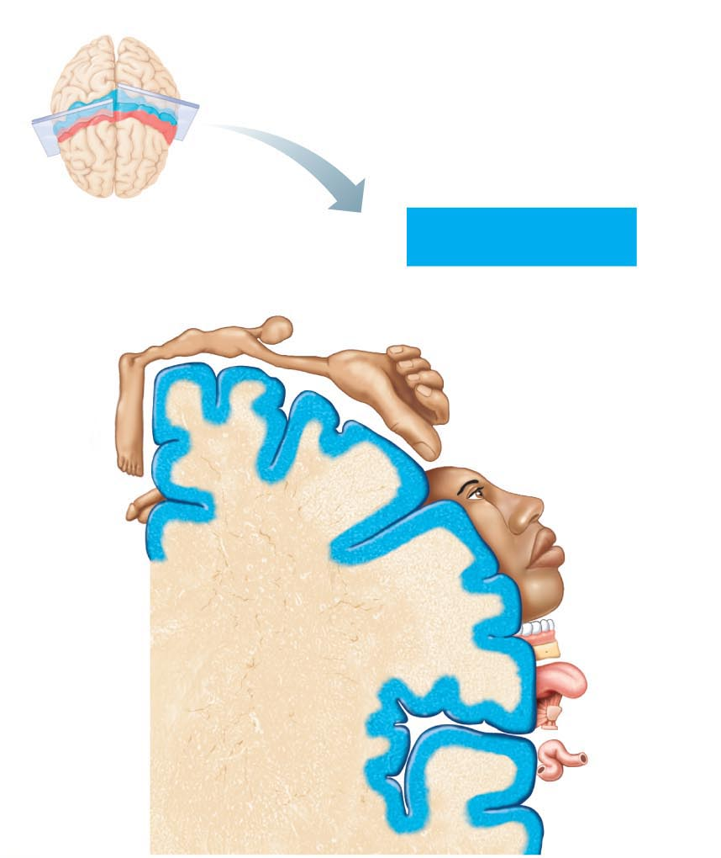
Figure 12.7b Body maps in the primary motor cortex and somatosensory cortex of the cerebrum.
Posterior
Sensory
Anterior
Sensory map in
postcentral gyrus
Head
Neck
Trunk
Forearm
Hip
Arm
Leg
Knee
Elbow
Hand
Fingers
Foot
Thumb
Eye
Nose
Face
Genitals
Lips
Teeth
Gums
Jaw
Tongue
Primary somato-
sensory cortex
(postcentral gyrus)
Pharynx
Intra-
abdominal

Slide 41
Somatosensory Association Cortex
Posterior to primary somatosensory cortex
Integrates sensory input from primary somatosensory cortex for understanding of object
Determines size, texture, and relationship of parts of objects being felt

Slide 42
Visual Areas
Primary visual (striate) cortex
  Extreme posterior tip of occipital lobe
  Most buried in calcarine sulcus of occipital lobe
  Receives visual information from retinas

Slide 43
Visual Areas
Visual association area
  Surrounds primary visual cortex
  Uses past visual experiences to interpret visual stimuli (e.g., color, form, and movement)
    E.g., ability to recognize faces
  Complex processing involves entire posterior half of cerebral hemispheres

Slide 44
Auditory Areas
Primary auditory cortex
  Superior margin of temporal lobes
  Interprets information from inner ear as pitch, loudness, and location
Auditory association area
  Located posterior to primary auditory cortex
  Stores memories of sounds and permits perception of sound stimulus

Slide 45
Vestibular Cortex
Posterior part of insula and adjacent parietal cortex
Responsible for conscious awareness of balance (position of head in space)

Slide 46
OIfactory Cortex
Primary olfactory (smell) cortex
  Medial aspect of temporal lobes (in piriform lobes)
  Part of primitive rhinencephalon, along with olfactory bulbs and tracts
  Remainder of rhinencephalon in humans part of limbic system
  Region of conscious awareness of odors

Slide 47
Gustatory Cortex
In insula just deep to temporal lobe
Involved in perception of taste

Slide 48
Visceral Sensory Area
Posterior to gustatory cortex
Conscious perception of visceral sensations, e.g., upset stomach or full bladder

Slide 49
Figure 12.6a Functional and structural areas of the cerebral cortex.
Motor areas
Central sulcus
Sensory areas and related
association areas
Primary motor cortex
Primary somatosensory
cortex
Premotor cortex
Somatic
sensation
Frontal
eye field
Somatosensory
association cortex
Broca's area
(outlined by dashes)
Gustatory cortex
(in insula)
Taste
Prefrontal cortex
Working memory
for spatial tasks
Wernicke's area
(outlined by dashes)
Executive area for
task management
Working memory for
object-recall tasks
Primary visual
cortex
Solving complex,
multitask problems
Visual
association
area
Vision
Auditory
association area
Primary
auditory cortex
Hearing
Lateral view, left cerebral hemisphere
Primary motor
cortex
Motor association
cortex
Primary sensory
cortex
Sensory
association cortex
Multimodal association
cortex

Slide 50
Figure 12.6b Functional and structural areas of the cerebral cortex.
Premotor
cortex
Cingulate
gyrus
Primary
motor cortex
Central sulcus
Corpus
callosum
Primary somatosensory
cortex
Frontal eye field
Parietal lobe
Prefrontal
cortex
Somatosensory
association cortex
Parieto-occipital
sulcus
Processes emotions
related to personal
and social interactions
Occipital
lobe
Orbitofrontal
cortex
Visual association
area
Olfactory bulb
Primary
visual cortex
Olfactory tract
Calcarine
sulcus
Fornix
Uncus
Parahippocampal
gyrus
Temporal
lobe
Primary
olfactory
cortex
Parasagittal view, right cerebral hemisphere
Primary motor
cortex
Motor association
cortex
Primary sensory
cortex
Sensory
association cortex
Multimodal association
cortex

Slide 51
Multimodal Association Areas
Receive inputs from multiple sensory areas
Send outputs to multiple areas, including premotor cortex
Allows meaning to information received, store in memory, tying to previous experience, and deciding on actions
Sensations, thoughts, emotions become conscious – makes us who we are

Slide 52
Multimodal Association Areas
Three broad parts:
  Anterior association area (prefrontal cortex)
  Posterior association area
  Limbic association area

Slide 53
Anterior Association Area (Prefrontal Cortex)
Most complicated cortical region
Involved with intellect, cognition, recall, and personality
Contains working memory needed for abstract ideas, judgment, reasoning, persistence, and planning
Development depends on feedback from social environment

Slide 54
Posterior Association Area
Large region in temporal, parietal, and occipital lobes
Plays role in recognizing patterns and faces and localizing us in space
Involved in understanding written and spoken language (Wernicke's area)

Slide 55
Limbic Association Area
Part of limbic system
Involves cingulate gyrus, parahippocampal gyrus, and hippocampus
Provides emotional impact that makes scene important and helps establish memories

